Slide 1

Session Hijacking
Volume 3, Module 1, v12, with v13 updates at the end

Slide 2
What is Session Hijacking?
You log into a website or web application
The server creates a session for you
The Session
The session is a unique identifier allowing the server to recognize and associate your requests with your user account
During your browsing session. It often involves the use of a session ID, which is stored as a cookie on your device.

Slide 3
Capturing the Session ID
Packet Sniffing
The attacker uses Packet Sniffing tools to capture or intercept traffic to reveal Session ID
Cross-Site Scripting (XSS)
Cross-Site Scripting (XSS) allows the hacker to inject malicious client-side scripts into a vulnerable website to gain access to data
Man-in-the Middle (MITM)
Man-in-the-Middle (MITM) intercept by places themselves between an authorized client and server so that Session ID passes through them when transmitted
Notes:
The attacker can guess or steal a valid session ID, which identifies authenticated users, and use it to establish a session with the server.
The web server responds to the attacker’s requests under the impression that it is communicating with an authenticated user.

Slide 4
Why Session Hacking is Successful
Lack of Encryption
Weak Session Management
Prolific XSS Vulnerabilities
Notes:
Lack of encryption: If data transmission between the user and the server is not encrypted, it becomes easier for attackers to intercept and manipulate the session data. Unencrypted communication allows attackers to read and alter the data, including session tokens, cookies, or other authentication credentials.
If a website does not implement account lockout, an attacker can make several attempts to connect with varying session IDs embedded in a genuine URL.
The attacker can continue making attempts until the actual session ID is determined.
This attack is also known as a brute-force attack.
During a brute-force attack, the web server does not display a warning message or complaint, allowing the attacker to determine the valid session ID.
Weak session management: Poorly implemented session management practices can make it easier for attackers to guess or brute-force session IDs, especially if the session tokens are predictable or have low entropy. Additionally, sessions that don't expire or have overly long expiration times provide a larger window of opportunity for attackers.
Cross-Site Scripting (XSS) vulnerabilities: XSS vulnerabilities can allow attackers to inject malicious scripts into web pages viewed by other users. When a victim visits the infected page, the attacker can steal their session information, such as cookies, which are then used to hijack the session.
Most websites use linear algorithms to predict variables such as time or IP address for generating session IDs.
By studying the sequential pattern and generating multiple requests, an attacker can easily narrow the search space necessary to forge a valid session ID.
Even if a strong session-ID generation algorithm is used, an active session ID can be easily determined if the string is short

Slide 5

Why is Session Hijacking Successful (Cont)
Insecure Handling of Session IDs
An attacker can retrieve stored session ID information by misleading the user’s browser
Indefinite Session Timeout
Session IDs with an indefinite expiration time provide the attacker with unlimited time to guess a valid Session ID
Notes:
An attacker can retrieve stored session-ID information by misleading the user’s browser into visiting another site. Before the session expires, the attacker can exploit the information in many ways, such as Domain Name System (DNS) poisoning, cross-site scripting exploitation, and the exploitation of a bug in the browser.
Session IDs with an indefinite expiration time provides an attacker with unlimited time to guess a valid session ID. An example of this is the “remember me” option in many websites.
The attacker can use static session IDs to the user’s web account after capturing the user’s cookie file.
The attacker can also perform session hijacking if they can break into a proxy server, which potentially logs or caches session IDs.

Slide 6

Session Hijacking and TCP/IP protocol
Most computers using TCP/Internet Protocol (IP) are vulnerable
  All machines running TCP/IP are vulnerable to session hijacking because of the design flaws inherent in TCP/IP
Most countermeasures do not work without encryption:
  If no encryption is present, then there are no countermeasures in place.
Notes:
It is easy to sniff session IDs in a flat network if transport security is not set up properly during the transmission of session ID cookies, even if a web application uses Secure Sockets Layer (SSL) encryption.
An attacker’s task becomes even easier if they capture session IDs containing actual login information.

Slide 7
Session Hijacking Process
It is easier for an attacker to masquerade as legitimate user.
An attacker can capture a user’s session by finding an established session and taking it over after user authentication.
During this period, all traffic intended for the user’s IP address goes to the attacker’s system
Notes:
It is easier for an attacker to sneak into a system as a genuine user than to enter a system directly.
An attacker can hijack a genuine user’s session by finding an established session and taking it over after user authentication.
After hijacking the session, the attacker can stay connected for hours without arousing suspicion.
During this period, all traffic intended for the user’s IP address goes to the attacker’s system instead, and the attacker can plant backdoors or gain additional access to the system.

Slide 8
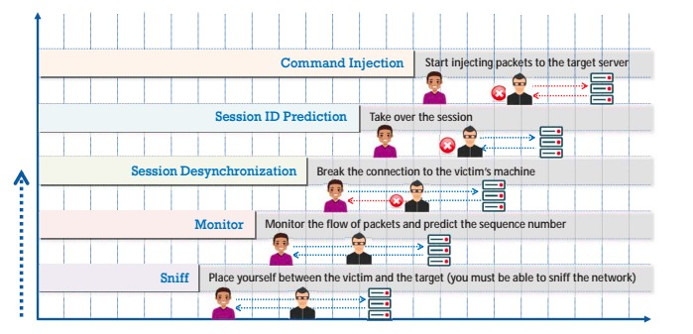
Session Hijacking Process
Copyright © by EC-Council. All Rights Reserved. Reproduction is Strictly Prohibited.

Slide 9

Passive and Active Session Hijacking
Passive
  An attacker hijacks a session then sits back, watches, and records all the traffic in that session
Active
  An attacker finds an active session and seizes control of it
Copyright © by EC-Council. All Rights Reserved. Reproduction is Strictly Prohibited.

Slide 10
Session Hijacking – Passive Hijacking
In passive session hijacking, the attacker intercepts and monitors the communication between the user's device and the server without actively altering the data being exchanged.
A passive attack uses sniffers on the network, allowing attackers to obtain information such as user IDs and passwords. The attacker can later use this information to log in as a valid user and enjoy the user’s privileges.
Notes:
Passive Session Hijacking In a passive attack, after hijacking a session, an attacker only observes and records all the traffic during the session.
A passive attack uses sniffers on the network, allowing attackers to obtain information such as user IDs and passwords. The attacker can later use this information to log in as a valid user and enjoy the user’s privileges.
Password sniffing is the simplest attack to obtain raw access to a network. Countering this attack involves methods that range from identification schemes (for example, one-time password systems such as S/KEY) to ticketing identification (for example, Kerberos).
These techniques help in protecting data from sniffing attacks, but they cannot protect against active attacks if the data are unencrypted or do not carry a digital signature.

Slide 11
Types of Session Hijacking:
Active Session Hijacking
Session Fixation
  The hacker tricks the user into using Session ID
Session Replay
  The hacker records legitimate session and replays later after the legitimate user logs out
Cross-Site Scripting
  The hacker injects malicious scripts into vulnerable websites
Notes:
Session Fixation: The attacker tricks the user into using a session ID or token that the attacker controls. This can be achieved by sending a specially crafted link or URL to the user or exploiting vulnerabilities in the application's session management process.
Session Replay: The attacker records a legitimate session and replays it later, possibly after the user has logged out, to gain unauthorized access to the system using the captured session data.
Cross-Site Scripting (XSS): By injecting malicious scripts into a vulnerable website, the attacker can hijack a user's session in the context of their web browser, allowing them to perform actions on the user's behalf.
Cross-Site Request Forgery (CSRF): In a CSRF attack, the attacker tricks the user's browser into making unauthorized requests to a targeted website, taking advantage of the user's active session on that website.
Man-in-the-Middle (MITM) Attack: The attacker intercepts and alters the communication between the user and the server, allowing them to modify requests, responses, or session tokens to gain control of the session.

Slide 12

Session Hijacking in OSI Model:
Network Layer
Network Layer
  The first layer impacted
  IP Spoofing to help facilitate a session hijacking
Notes:
Network Layer: The network layer handles routing and forwarding of data packets between different networks. While session hijacking is not a primary concern at this layer, an attacker might use network-layer techniques like IP spoofing to facilitate session hijacking.

Slide 13
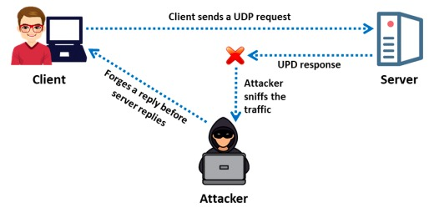
Session Hijacking in OSI Model:
Transport Layer: Hijacking
Attackers attempt to exploit vulnerabilities in the transport layer to manipulate and take control of existing sessions
Copyright © by EC-Council. All Rights Reserved. Reproduction is Strictly Prohibited.
Notes:
Transport Layer: The transport layer, such as TCP (Transmission Control Protocol) or UDP (User Datagram Protocol), is where session hijacking attacks often take place. Attackers can attempt to exploit vulnerabilities in the transport layer protocols to manipulate and take control of existing sessions.

Slide 14

Presentation Session Hijacking
The presentation layer is the point in the OSI model in which security methods such as encryption and security mechanisms can be implemented to prevent attacks.
This layer is being exploited by not being implemented
Notes:
Presentation Layer: The presentation layer is responsible for data format conversion, encryption, and compression. While session hijacking doesn't directly target this layer, encryption and security mechanisms implemented at this layer can help prevent unauthorized access to the session data.

Slide 15

Application-Level Session Hijacking
Techniques such as stealing, guessing, and brute forcing to obtain a valid session ID, which helps in acquiring control over a valid user’s session while it is in progress.
Notes:
Application Layer: The application layer is where most session hijacking attacks target. This layer includes the application-specific protocols and services used for user interactions, such as HTTP, FTP, SMTP, etc. Attackers often exploit application vulnerabilities, such as flaws in session management, authentication mechanisms, or weaknesses in web applications, to perform session hijacking attacks.

Slide 16
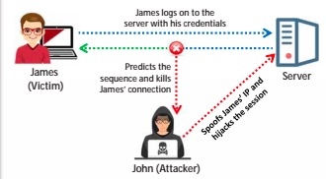
Application-Level Session Hijacking
Protocols Impacted on Application Layer: HTTP, FTP, SMTP, etc.
Application-level Session Hijacking uses methods suck as session sniffing and predictable session tokens
The attacker steals or predicts a valid session to gain unauthorized access to a web server
Copyright © by EC-Council. All Rights Reserved. Reproduction is Strictly Prohibited.
Notes:
This section discusses application level session hijacking and various methods to compromise the session token, such as session sniffing and the use of predictable session tokens.
In application level session hijacking, an attacker steals or predicts a valid session to gain unauthorized access to a web server.

Slide 17
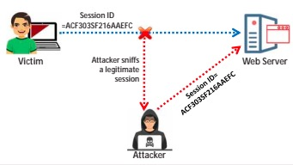
Application-Level Session Hijacking: Stealing
An attacker can steal the session key through physical access, such as acquiring the files with Session IDs or memory contents of either the user’s system or the server
The attacker can use sniffing tools, such as Wireshark, to sniff the traffic between the client and server to extract the Session IDs from the packets
Copyright © by EC-Council. All Rights Reserved. Reproduction is Strictly Prohibited.
Notes:
Thus, guessing techniques are effective only when servers use weak or flawed session-ID generation mechanisms.
Attacker guesses the session IDs by observing session variables. In the case of session hijacking, the range of session ID values that can be guessed is limited.

Slide 18
Application-Level Session Hijacking: Guessing
The attacker attempts to guess the Session IDs by observing session variables
The range of Session ID values that can be guessed is limited
Guessing techniques are only effective when servers use weak or flawed Session-ID generation mechanisms

Slide 19
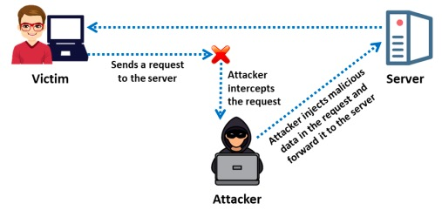
Spoofing vs. Hijacking
In Blind Session Hijacking, the attacker does not have access to the data exchanged between the client and server
The attack is blind to the data being exchanged because of encryption
TCP segments provide the initial sequence number (ISN) as a part of the segment header, which the attacker must guess
Copyright © by EC-Council. All Rights Reserved. Reproduction is Strictly Prohibited.
Notes:
In blind hijacking, an attacker predicts the sequence numbers that a victim host sends to create a connection that appears to originate from the host or a blind spoof.
To understand blind hijacking, it is important to understand sequence-number prediction. TCP sequence numbers, which are unique per byte in a TCP session, provide flow control and data integrity.
TCP segments provide the initial sequence number (ISN) as a part of each segment header. ISNs do not start at zero for each session
As part of the handshake process, each participant needs to state the ISN, and bytes are numbered sequentially from that point.
Blind session hijacking relies on the attacker’s ability to predict or guess sequence numbers.
An attacker is unable spoof a trusted host on a different network and observe the reply packets because no route exists for the packets to return to the attacker’s IP address.

Slide 20

Spoofing vs. Hijacking Summary
Hijacking non-encrypted TCP communications requires:
the presence of non-encrypted session-oriented traffic
the ability to recognize TCP sequence numbers to predict the next sequence number (NSN)
On the local segment, a hacker can poison the ARP caches on the two legitimate hosts of a session by sniffing and predicting the ISN + 1 number and routing the traffic back to them
Notes:
In summary, the hijacking of non-encrypted TCP communications requires the presence of non-encrypted session-oriented traffic, the ability to recognize TCP sequence numbers from which the next sequence number (NSN) can be predicted, and the ability to spoof a host’s media access control (MAC) or IP address to receive communications that are not destined for the attacker’s host.

Slide 21
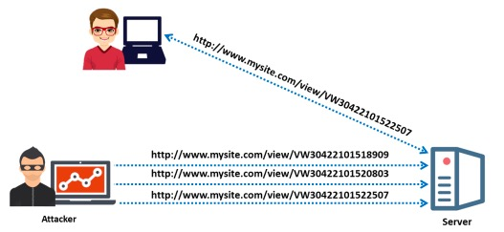
Application-Level Session Hijacking: Brute Forcing
With brute-force technique, the attacker obtains Session IDs by attempting all possible permutations
An attacker using a digital subscriber line (DSL) can generate up to 1,000 Session IDs/second
Brute-Force attacks are most useful when the algorithm producing Session IDs is not random
Copyright © by EC-Council. All Rights Reserved. Reproduction is Strictly Prohibited.

Slide 22
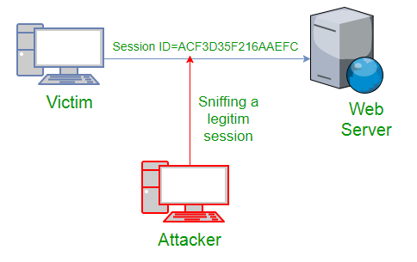
Compromising Session IDs Using Sniffing
Copyright © by EC-Council. All Rights Reserved. Reproduction is Strictly Prohibited.
Notes:
A web server identifies a user’s connection through a unique session ID (also known as a session token).
The web server sends a session token to the client browser after the successful authentication of client login
Usually, a session token comprises a string of variable width that is useful in various ways, such as in the header of an HTTP requisition (cookie), in a URL, or in the body of an HTTP requisition.
An attacker uses packet sniffing tools such as Wireshark and Steel Central Packet Analyzer to intercept the HTTP traffic between a victim and web server.
The attacker then analyzes the data in the captured packets to identify valuable information such as session IDs and passwords.
Once the session ID is determined, the attacker masquerades as the victim and sends the session ID to the web server before the victim does.
The attacker uses the valid token session to gain unauthorized access to the web server. In this manner, the attacker takes control over an existing legitimate session.

Slide 23
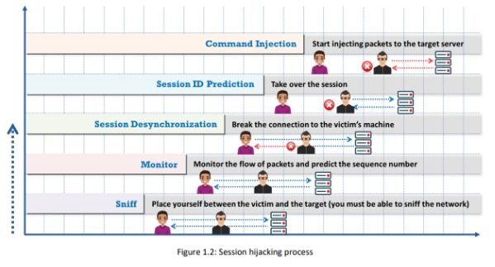
Compromising Session IDs by Predicting Session Token
Notes:
A session ID is tagged as proof of an authenticated session established between a user and web server. Thus, if an attacker can guess or predict the session ID of the user, fraudulent activity is possible.
Session prediction enables an attacker to bypass the authentication schema of an application. Usually, attackers can predict session IDs generated by weak algorithms and impersonate a website user.
Attackers analyze a variable section of session IDs to determine the existence of a pattern
This analysis is performed either manually or by using various cryptanalytic tools.

Slide 24
Compromising Session IDs by Predicting Session Token
An attacker collects a large amount of simultaneous session IDs to gather samples in the same time window and keep the variable constant.
1
The attacker collects valid Session IDs useful in identifying authenticated users
2
The attacker studies the Session ID structure, information used to generate it, and the algorithm used by the web application to secure it
3
The attacker uses this information to predict the Session ID.
Attackers can only guess Session IDs using a brute-force technique where they generate and test different Session ID values until they gain access

Slide 25
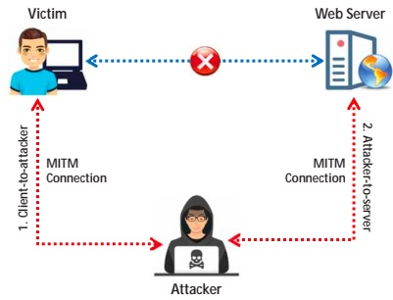
Compromising Session IDs Using Man-in-the-Middle Attack
A man-in-the-middle (MITM) attack intrudes into an existing connection between systems and intercepts messages being transmitted
Attackers use different techniques and split a TCP connection into two:
Client-to-attacker
Attacker-to-server
After successfully intercepting a TCP connection, an attacker can read, modify, and insert fraudulent data into the intercepted communication
In an HTTP transaction, the TCP connection between the client and server is targeted
Copyright © by EC-Council. All Rights Reserved. Reproduction is Strictly Prohibited.

Slide 26
Compromising Session IDs Using Man-in-the-Browser Attack
A man-in-the-browser attack is similar to an MITM attack
The man-in-the-browser is different from an MITM attack because it uses a Trojan horse to intercept and manipulate calls between a browser and its security mechanisms or libraries
An attacker positions a previously installed Trojan between the browser and its security mechanism, allowing it to modify web pages and transaction content or insert additional transactions

Slide 27
CEHv13 Update – Advanced Session Hijacking Techniques
CEHv13 highlights expanded threat vectors such as:
  Man-in-the-Browser (MitB) attacks using injected trojans (common in banking malware)
  Cloud session hijacking due to poor token invalidation across federated apps (e.g., SSO misuse)
  Browser exploitation frameworks (BeEF) used to automate client-side session manipulation
New focus on hijacking JWTs and OAuth tokens, especially in SPA/web API environments
Attackers increasingly leverage AI-based brute force models to predict or generate weak session tokens

Slide 28
CEHv13 Update – Detection & Prevention Strategies
Enhanced defenses emphasized in CEHv13:
  Session binding to IP/device fingerprint to prevent reuse
  Use of Secure, HttpOnly, and SameSite cookie attributes to mitigate XSS and fixation
  Short session lifespans and forced re-authentication after privilege elevation
  Monitoring for token reuse across geolocations or devices
AI-based session defense tools now:
  Flag abnormal token reuse patterns
  Detect token replay across session expiration boundaries
Industry examples: Azure AD Conditional Access, Google Cloud session risk scoring

Slide 29

Evading IDS, Firewalls and Honeypots
EC Council
Volume 3, Module 2, v12, with v13 additions at the end

Slide 30

Overview IDS and IPS
IDS/IPS
  software or hardware device
  Monitor network for malicious activities
  passive - IDS
  active - IPS
Firewall
  software or hardware
  protects a private network
  between two networks - usually between private network and public
Honeypot
  simulates a target but does not store any sensitive information
  usually is poorly secured allowing a hacker to easily bypass its security measures

Slide 31
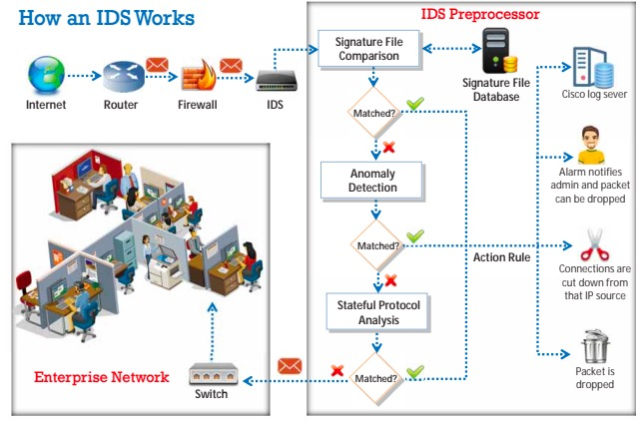
Intrusion Detection Overview
An intrusion detection system (IDS) is a software system or hardware device that inspects all inbound and outbound network traffic for suspicious patterns that may indicate a network or system security breach
The IDS checks traffic for signatures that match known intrusion patterns and signals an alarm when a match is found
Depending on the traffic to be monitored, the IDS is placed outside/inside the firewall to monitor suspicious traffic originating from outside/inside the network
Copyright © by EC-Council. All Rights Reserved. Reproduction is Strictly Prohibited.
Notes:
An intrusion detection system (IDS) is a security software or hardware device used to monitor, detect, and protect networks or systems from malicious activities; it alerts the concerned security personnel immediately upon detecting intrusions. IDS are extremely useful as they monitor the inbound/outbound traffic of the network and check for suspicious activities continuously to detect a network or system security breach

Slide 32
How an IDS Detects an Intrusion
          Signature recognition, also known as misuse detection, tries to identify events that indicate an abuse of a system or network resource
Signature Recognition
          It detects the intrusion based on the fixed behavioral characteristics of the users and components in a computer system
Anomaly Detection
          In this type of detection, models are built to explore anomalies in the way in which vendors deploy the TCP/IP specification
Protocol Anomaly Detection
Copyright © by EC-Council. All Rights Reserved. Reproduction is Strictly Prohibited.
Notes:
An IDS gathers and analyzes information from within a computer or a network to identify possible violations of the security policy, including unauthorized access, as well as misuse.
An IDS is also referred to as a “packet sniffer,” which intercepts packets traveling via various communication media and protocols, usually TCP/IP.
The packets are analyzed after they are captured. ▪ An IDS evaluates traffic for suspected intrusions and raises an alarm upon detecting such intrusions.

Slide 33
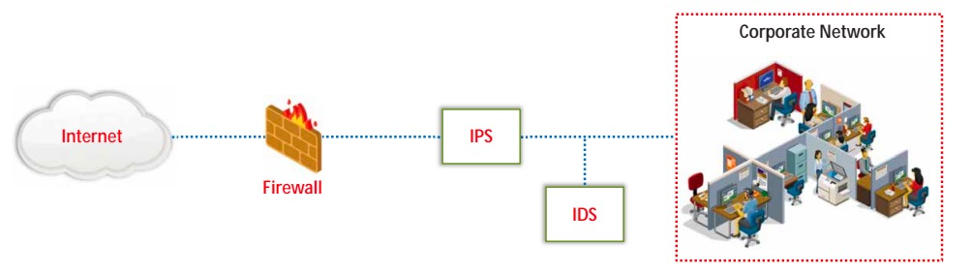
Intrusion Prevention IPS
Intrusion Prevention System (IPS)
An intrusion prevention system (IPS) is also considered an active IDS since it is capable of not only detecting the intrusions but also preventing them
It is a continuous monitoring system that often sits behind the firewalls as an additional layer of protection
Unlike an IDS, which is passive, an IPS is placed inline in the network, between the source and destination to actively analyze the network traffic and to automatically take decisions on the traffic that is entering the network
Copyright © by EC-Council. All Rights Reserved. Reproduction is Strictly Prohibited.
Notes:
Intrusion Detection Tools Intrusion detection tools detect anomalies. These tools, when running on a dedicated workstation, read all network packets, reconstruct user sessions, and scan for possible intrusions by looking for attack signatures and network traffic statistical anomalies

Slide 34
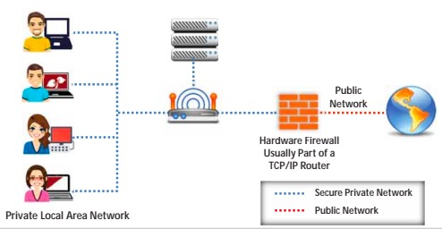
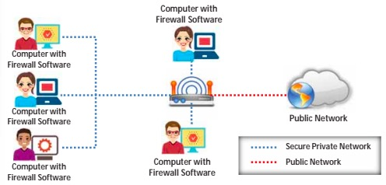
Firewall Types
Types of Firewalls
Hardware Firewalls
A hardware firewall is either a dedicated stand-alone hardware device or it comes as part of a router
The network traffic is filtered using the packet filtering technique
It is used to filter out the network traffic for large business networks
Software Firewalls
A software firewall is a software program installed on a computer, just like normal software
It is generally used to filter traffic for individual home users
It only filters traffic for the computer on which it is installed, not for the entire network
Note: It is recommended that you configure both a software and hardware firewall for best protection
Copyright © by EC-Council. All Rights Reserved. Reproduction is Strictly Prohibited.
Notes:
Hardware firewall is a dedicated, standalone device that provides robust security at the network level and can protect multiple devices, whereas a software firewall is installed on individual devices and provides security at the host level. Both hardware and software firewalls play critical roles in securing networks and systems, and often a combination of both is employed to create a layered and comprehensive security strategy.
Software-based: A software firewall is a piece of security software installed directly on a computer or server. It operates as a program within the operating system and is dependent on the host's resources.

Slide 35
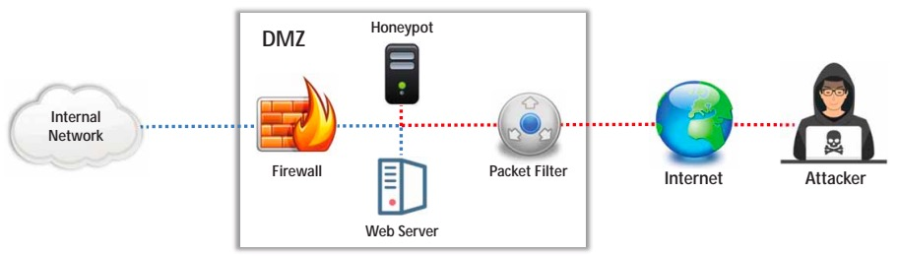
HoneyPots
Honeypot
1
A honeypot is an information system resource that is expressly set up to attract and trap people who attempt to penetrate an organization’s network
2
It has no authorized activity, does not have any production value, and any traffic to it is likely to be a probe, attack, or compromise
3
A honeypot can log port access attempts or monitor an attacker’s keystrokes. These could be early warnings of a more concerted attack
Copyright © by EC-Council. All Rights Reserved. Reproduction is Strictly Prohibited.

Slide 36
IDS Evasion Techniques
Evasion
Insertion Attack
Obfuscating
Time-to-Live Attacks
DoS Attack
Notes:
DS that provide an extra layer of security to the organization’s infrastructure are interesting targets for attackers. Attackers implement various IDS evasion techniques to bypass such ecurity mechanisms and compromise the infrastructure. IDS evasion is the process of modifying attacks to fool the IDS/IPS into interpreting that the traffic is legitimate and thus prevent the IDS from triggering an alert. Many IDS evasion techniques can perform IDS evasion in different and effective ways.

Slide 37
Denial-of-Service Attack (DoS)
Many IDSs use a centralized server for logging alerts
If the attackers know the IP address of the centralized server, they can perform DoS or other hacks to slow down or crash the server
As a result, the attackers’ intrusion attempts will not be logged
Causes the device to lock up
1
Causes personnel to be unable to investigate all the alarms
2
Using this evasion technique, an attacker:
Causes more alarms than can be handled by management systems (such as databases)
3
Fills up disk space causing attacks not to be logged
4
Consumes the device’s processing power and allows attacks to sneak by
5
Copyright © by EC-Council. All Rights Reserved. Reproduction is Strictly Prohibited.
Notes:
The attacker identifies a point of network processing that requires the allocation of a resource, causing a condition to occur in which all of that resource is consumed. The resources affected by the attacker are CPU cycles, memory, disk space, and network bandwidth.

Slide 38
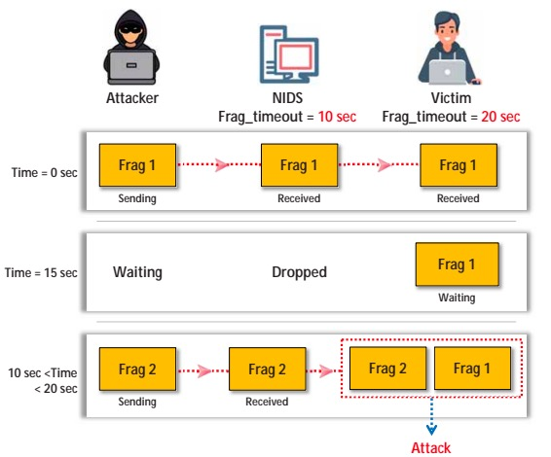
Fragmentation Attack
Fragmentation Attack
Fragmentation can be used as an attack vector when fragmentation timeouts vary between the IDS and the host
If the fragment reassembly timeout is 10 sec at the IDS and 20 sec at the target system, attackers will send the second fragment 15 sec after sending the first
In this scenario, the IDS will drop the fragments as the second fragment is received after its reassembly time, but the target system will reassemble the fragments
Attackers will keep sending the fragments with 15 sec delays until all the attack payload is reassembled at the target system
Copyright © by EC-Council. All Rights Reserved. Reproduction is Strictly Prohibited.
Notes:
A fragmentation attack is a type of network security attack that exploits the way network packets are broken down or fragmented and reassembled by networking devices and operating systems. The attack takes advantage of inconsistencies in handling fragmented packets to deceive or bypass security measures, potentially leading to unauthorized access or data manipulation.

Slide 39
Evading Firewall
Firewall Evasion Techniques
Port Scanning
1
Using an IP Address in Place of a URL
SSH Tunneling
6
10
Banner Grabbing
2
Using a Proxy Server
DNS Tunneling
7
11
IP Address Spoofing
3
ICMP Tunneling
Through Content
8
12
Source Routing
4
ACK Tunneling
Through XSS Attack
9
13
Tiny Fragments
5
Copyright © by EC-Council. All Rights Reserved. Reproduction is Strictly Prohibited.

Slide 40
Bypass Firewall Blocked Sites
Bypass a Firewall Using a Proxy Server
Find an appropriate proxy server
1
In a Windows system, Go to Control Panel, select Network and Internet → Internet Options and in the Internet Options dialog box under Connections tab, click “LAN settings”
2
Under LAN Settings, click on the “Use a proxy server for your LAN” check box
3
In the Address box, type the IP address of the proxy server
4
In the Port box, type the port number that is used by the proxy server for client connections (by default, 8080)
5
Click to select “Bypass proxy server for local addresses” check box if you do not want the proxy server computer to be used when connected to a computer on the local network
6
Click OK to close the LAN Settings dialog box
7
Click OK again to close the Internet Options dialog box
8
Copyright © by EC-Council. All Rights Reserved. Reproduction is Strictly Prohibited.

Slide 41
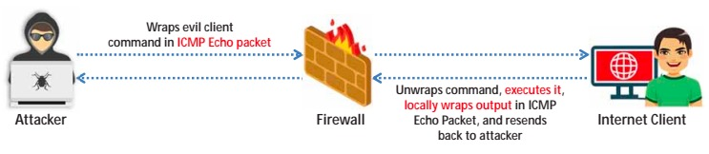
Bypass Firewall Tunneling
Bypassing Firewalls through the ICMP Tunneling Method
ICMP tunneling allows tunneling a backdoor shell in the data portion of ICMP Echo packets
RFC 792, which delineates ICMP operations, does not define what should go in the data portion
The payload portion is arbitrary and is not examined by most of the firewalls, thus any data can be inserted in the payload portion of the ICMP packet, including a backdoor application
Some administrators keep ICMP open on their firewall because it is useful for tools like ping and traceroute
Assuming the ICMP is allowed through a firewall, use Loki ICMP tunneling (https://www.cisco.com) to execute commands of choice by tunneling them inside the payload of the ICMP echo packets
Copyright © by EC-Council. All Rights Reserved. Reproduction is Strictly Prohibited.
Notes:
Bypassing a firewall using tunneling is a technique employed to circumvent the security restrictions imposed by a firewall and gain unauthorized access to restricted resources or services on the internet or within a private network. Tunneling involves encapsulating the original data traffic within a different protocol, allowing it to pass through the firewall undetected or unblocked.

Slide 42

Detecting Honeypots
Attackers perform honeypot detection using various tools and techniques:
  Send-safe Honeypot Hunter (http://www.send-safe.com)
  kippo_detect (https://github.com)
  using multi-proxies (TORs)
  using encryption and steganography
Notes:
Kippo is an open-source SSH honeypot designed to mimic a real SSH server and record the activities of potential attackers. It captures and logs attackers' actions, including their login attempts, commands executed, and more. In this scenario, we will create a simple application that uses Kippo to detect and record SSH-based attacks.

Slide 43
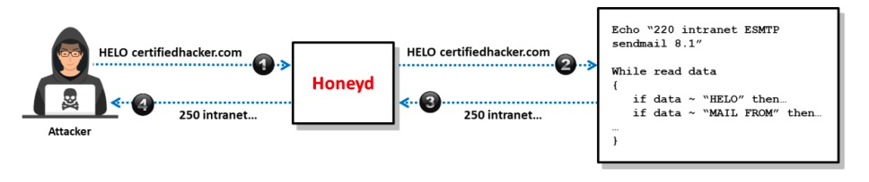
Bypass Firewall Tunneling
Detecting Honeyd
Detecting the Presence of Honeyd Honeypot
Honeyd is a widely used honeypot daemon used to create thousands of honeypots easily
It is a network-simulated and service-simulated honeypot deployment engine
This honeyd honeypot can respond to a remote attacker who tries to contact the SMTP service with fake responses
Copyright © by EC-Council. All Rights Reserved. Reproduction is Strictly Prohibited.

Slide 44

CEHv13 Update – Modern Evasion Tactics
CEHv13 introduces advanced evasion scenarios involving:
  AI-driven traffic shaping to mimic legitimate user behavior
  Encrypted tunneling via ICMP, DNS, and HTTPS payloads
  Use of adversarial machine learning to confuse anomaly-based detection systems
Real-world attackers now test evasion success using tools that simulate modern XDR/SIEM environments
Defensive systems must now account for automated evasion and toolkits like Loki, Shellter, and Powershell obfuscation frameworks

Slide 45
CEHv13 Update – Detection & Countermeasures in AI-Driven Networks
Increased adoption of AI/ML in IDS/IPS platforms like Snort, Suricata, and Zeek
Emphasis on using:
  Behavioral baselining for anomaly detection
  Deception technology (adaptive honeypots, moving target defense)
Defensive strategy shift:
  From static rule matching to adaptive heuristics
  From known signatures to predictive indicators of compromise (IoC)
New CEHv13 focus: Understanding how attackers manipulate AI to evade learning models

Slide 46

Conclusion
Summary
There are many tools and methods to evade a firewall or associated IDS, IPS
The actual purpose of evading will determine the tool as well as the environmental target
It is important to remember this is an overview; do not forget to access your textbook through Canvas

